Slide 1

MS Lifecam HD 3000 Determining FoV and specs (needed for Apriltag distance and angle calculations)
2022 1226
Cory Hill, Mentor, FRC 2429

Slide 2
Camera calibrations – why we need them
The most basic part of using vision processing to find distances is knowing the camera field of view in degrees and the true size of your object
This is an Apriltag pipeline –
Import the detector class
Create a detector object
Use the camera intrinsics and tag size when you feed it an image
Get the distances and angles from the detect method
from pupil_apriltags import Detector # apriltag processor
# create a detector object
at_detector = Detector( families="tag16h5", nthreads=2, quad_decimate=1.0, quad_sigma=0.0, refine_edges=1, decode_sharpening=0.25, debug=0)
# define our camera and target parameters
ms_lifecam_1280_calculated = [1104.1, 1104.7, 640, 360] # format is [fx, fy, cx, cy] - all in pixels
tag_size = 0.1524 # that's how many meters across we are
# feed it an image
detections = at_detector.detect(grey_image, estimate_tag_pose=True, camera_params=ms_lifecam_1280_calculated, tag_size=tag_size)
Example results from detections -
Detection object: tag_family = b'tag16h5' tag_id = 2 hamming = 0 decision_margin = 60.5988883972168 homography = [[ 5.07677692e+01 3.06238074e+01 7.98896578e+02] [-1.18864247e+01 1.01827896e+02 2.50278944e+02] [-5.10166146e-02 3.67707104e-02 1.00000000e+00]] center = [798.89657777 250.2789442 ] corners = [[715.9052124 334.61804199] [893.0098877 345.13720703] [897.86138916 149.70700073] [707.42706299 158.08540344]] pose_R = [[ 0.91701389 0.05693167 0.39477122] [ 0.05425629 0.96275515 -0.26487501] [-0.3951478 0.26431288 0.87977095]] pose_t = [[ 0.13013255] [-0.08998864] [ 0.89541514]] pose_err = 1.2919193463695032e-05,

Slide 3
Camera calibration background
https://www.skiprobotics.com/articles/2021-08-13-camera-calibration/
https://ksimek.github.io/2013/08/13/intrinsic/

Slide 4
Understanding the native cropping
MS Lifecam HD 3000

Slide 5
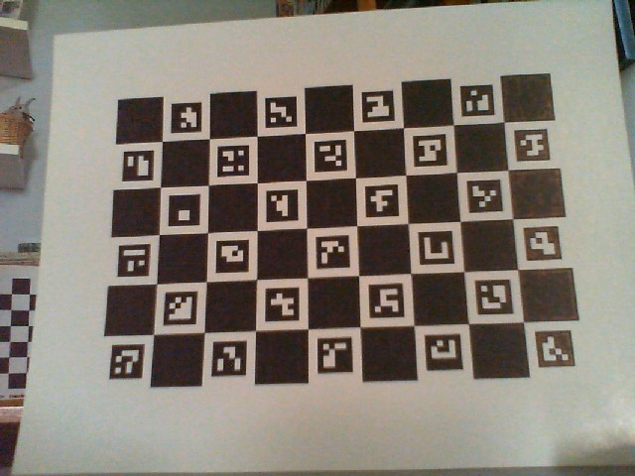
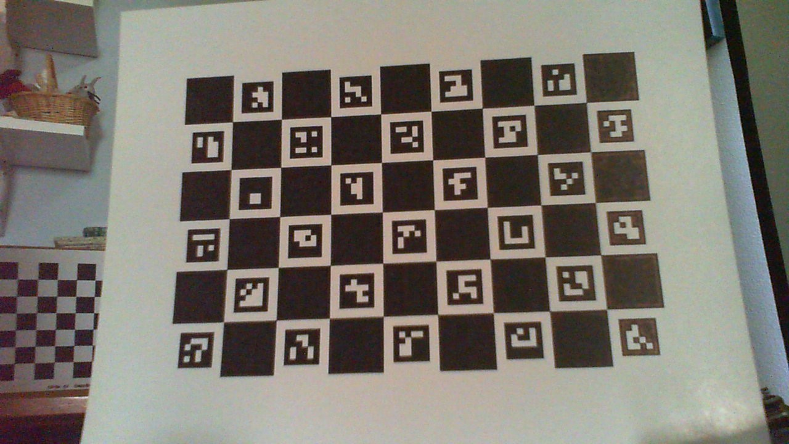
Same scene overlay of 1280x720 (red outline) and 640x480 (added alpha, blue outline)
Will have different FoV in x and y.
Note how sensor crops x cols but GAINS y rows when going to 640x480

Slide 6
Calculating the nominal intrinsics
MS Lifecam HD 3000

Slide 7
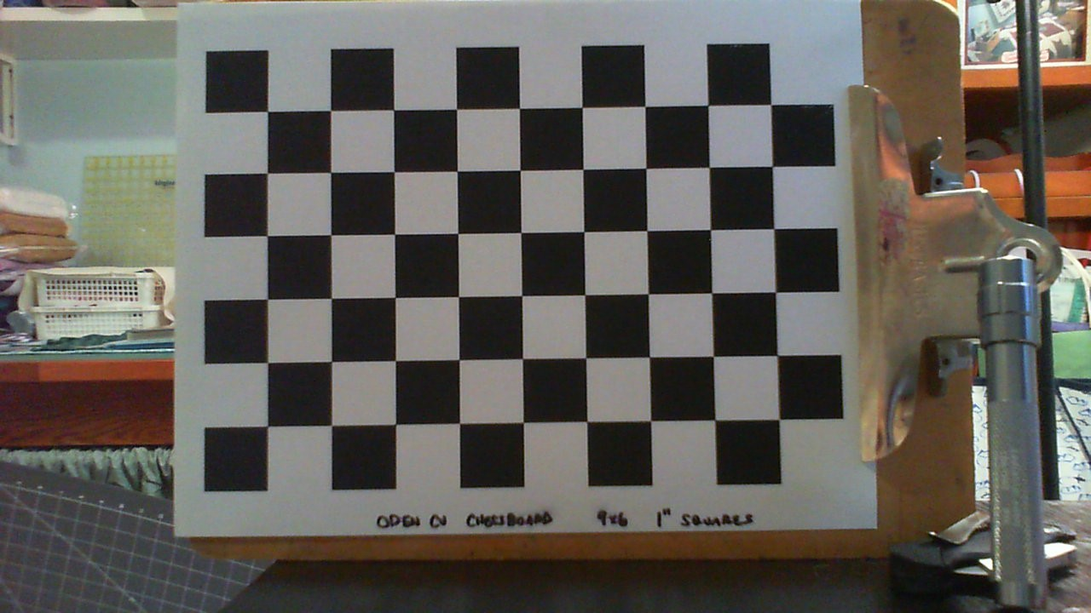
1280x720 FoV - 15.0” distance, 1” squares
10” in x = 738 pixels, so 73.8 per pixel. 1280/73.6 = 17.39” across
6” in y = 443 pixels, so 73.8 inches per. 720/73.6 = 9.78” high
Not accounting for distortion (need a bigger target/ get closer for that)
Fov_x = 2*arctan(17.39/2 / 15) = 60.2°
Fov_y = 2*arctan(9.78/2 / 15) = 36.1°
Diagonal Fov likely 2*arctan(1468.6/73.6/2/ 15) = 67.3 ° (within 1.2° of spec)

Slide 8
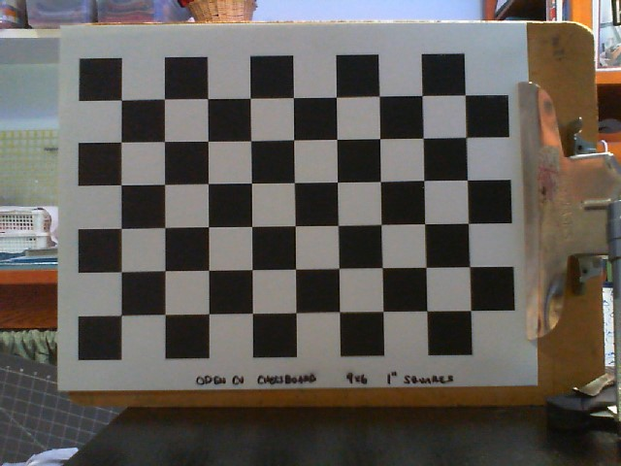
640x480 FoV - 15.0” distance, 1” squares
10” in x = 448 pixels, so 44.8 per pixel. 640/44.8 = 14.28” across
7” in y = 312 pixels, so 44.6 inches per. 480/44.6 = 10.76” high
Not accounting for distortion (need a bigger target / get closer for that)
Fov_x = 2*arctan(14.28 /2 / 15) = 50.1°
Fov_y = 2*arctan(10.76 /2 / 15) = 39.4°
Diagonal Fov likely 2*arctan(800/44.7/2/ 15) = 61.6 °

Slide 9
Camera models – estimating the intrinsics
fx_predicted = 0.5 * w / np.tan(0.5 * np.deg2rad(w_fov))
fy_predicted = 0.5 * h / np.tan(0.5 * np.deg2rad(h_fov))
h, w = 720, 1280
w_fov = 60.2
h_fov = 36.1
fx_predicted = 1104.1
fy_predicted = 1104.7
cx_predicted = 1280/2 = 640
cy_predicted = 720/2 = 360
h, w = 480, 640
w_fov = 50.1
h_fov = 39.4
fx_predicted = 684.7
fy_predicted = 670.2
cx_predicted = 640/2 = 320
cy_predicted = 480/2 = 240
[ 1104.1, 1104.7, 640, 360 ]
[684.7, 670.2, 320, 240 ]
We can feed these to apriltag.detector() for a generic Lifecam HD 3000
Distances will be quite close, but center offsets will not be exact

Slide 10
Comparison of calibration techniques
MS Lifecam HD 3000

Slide 11
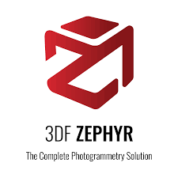
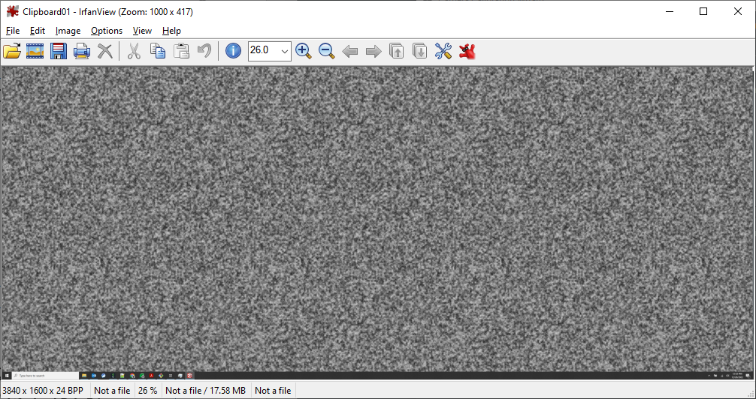
Calibration techniques: 3DF Zephyr Free
h, w = 720, 1280
w_fov = 60.2
h_fov = 36.1
fx_predicted = 1104.1
fy_predicted = 1104.7
cx_predicted = 1280/2 = 640
cy_predicted = 720/2 = 360
h, w = 480, 640
w_fov = 50.1
h_fov = 39.4
fx_predicted = 684.7
fy_predicted = 670.2
cx_predicted = 640/2 = 320
cy_predicted = 480/2 = 240
Nominal : [ 1104.1, 1104.7, 640, 360 ]
3DF: [1142.9, 1142.9, 650.9, 354.7]
evens [1144.5, 1144.5, 654.3, 364.6]
odds [1152.9, 1152.9, 649.4, 352.3]
Just the 4 biggest images: [1121.9 1121.9, 651.3, 360.4]
Nominal: [684.7, 670.2, 320, 240 ]
3DF: [681.6, 681.6, 322.6, 243.8]
Result with subsets of cal images:
Just evens [652.3, 652.3, 325.2. 237.3]
Just odds [692.4, 692.4, 210.2, 244.6]
Need to see which images cause the most noise, but 3DF Zephyr is pretty stable. Their cal image is shown on right. Cal wants a minimum of 3 images. More images seems to get to a more accurate result (as it should) – see later slides

Slide 12

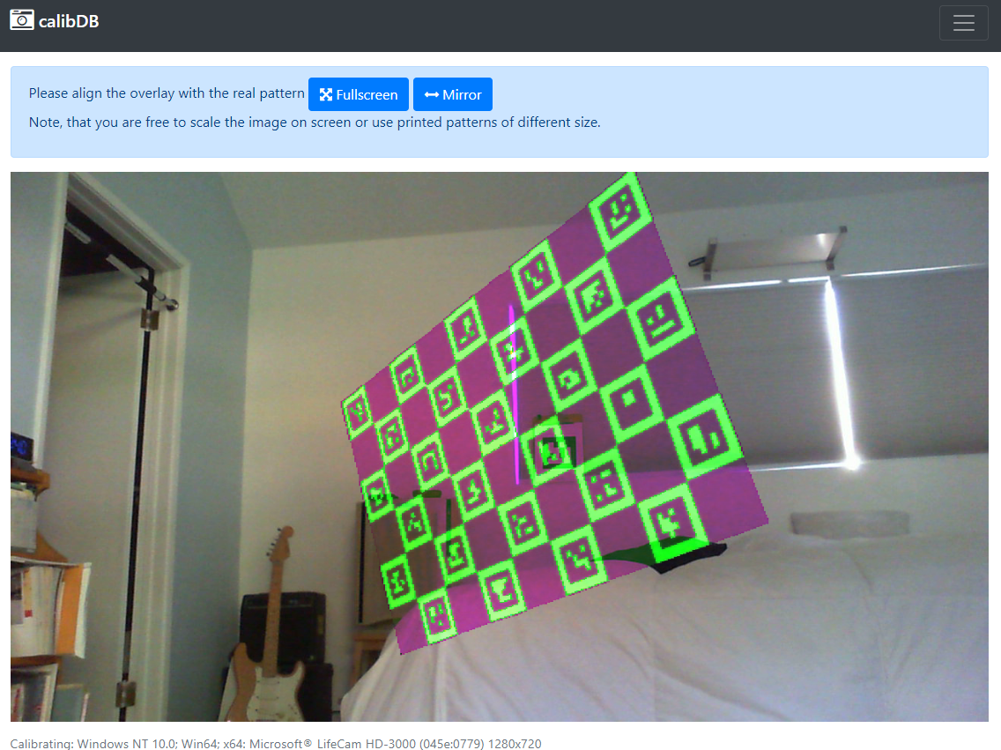
Calibration techniques: calibdb.net
h, w = 720, 1280
w_fov = 60.2
h_fov = 36.1
Nominal : [ 1104.1, 1104.7, 640, 360 ]
h, w = 480, 640
w_fov = 50.1
h_fov = 39.4
Nominal: [684.7, 670.2, 320, 240 ]
Calibdb: [1120.5, 1119.7, 640.1, 353.7]
It’s cropping incorrectly from the 1280 data
Not sure how to fix that
Calibdb: [747.0, 746.4, 320.5, 235.8 ]
Has its own web interface at https://calibdb.net/ and custom target. Can’t get a good 640x480 cal out of calibdB – it can’t predict the way we’re cropping in slide 3

Slide 13


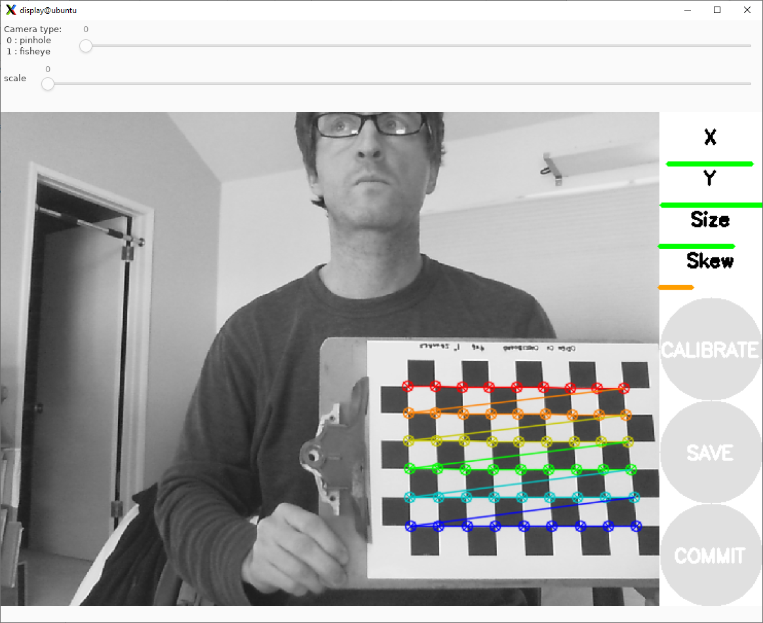
Calibration techniques: ros2 cameracalibrator
h, w = 720, 1280
w_fov = 60.2
h_fov = 36.1
Nominal : [ 1104.1, 1104.7, 640, 360 ]
h, w = 480, 640
w_fov = 50.1
h_fov = 39.4
Nominal: [684.7, 670.2, 320, 240 ]
ros2:
first try [680.3, 685.8, 306.5, 244.6 ]
second try: [ 672.5, 672.5, 314.1, 252.2]
ros2: [1080.8, 1076.8, 643.2, 351.3]
This one is quite nice – lets you know if you have enough data for a good cal. Takes a while to calculate though. However, gives the right matrices to feed to ROS’ aprilcal.
Had to set up ros2 on a pi and run everything.
Still has a some variation from cal to cal.

Slide 14
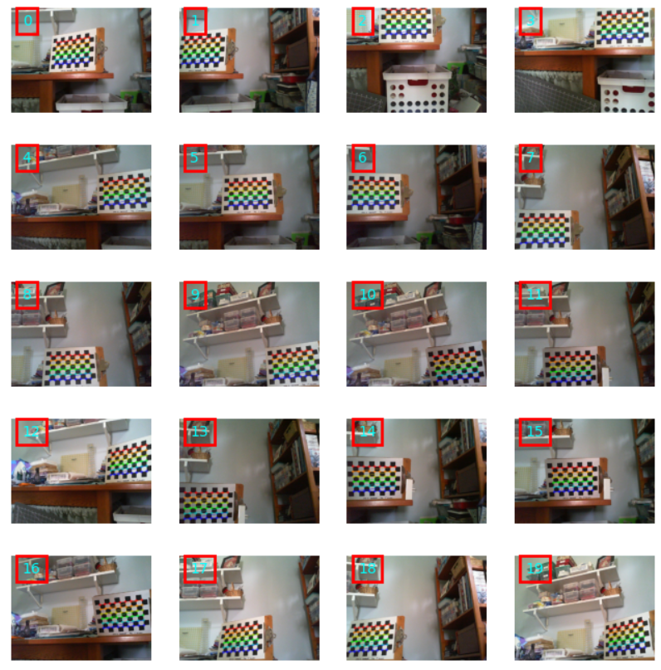
Calibration techniques: opencv IS TERRIBLE
h, w = 720, 1280
w_fov = 60.2
h_fov = 36.1
Nominal : [ 1104.1, 1104.7, 640, 360 ]
h, w = 480, 640
w_fov = 50.1
h_fov = 39.4
Nominal: [684.7, 670.2, 320, 240 ]
:
:
I built the standard opencv demo pipeline on this, but the default method seems to be terrible – super unstable.
You can’t really get configuration wrong, because the only input is the images themselves
I can’t get anywhere close to the nominal prediction, regardless of image placement and tilt/skew.
Huge variation when leaving out one image
Tried with sets of 9 like most of what you see on the internet, then went up to 45 with 9 each of flat, tilt left, tilt right, tilt forward, tilt back
Nothing got me close to nominal
So I started changing the parameters
If you supply a good guess and lock the aspect ratio, it gets a lot better

Slide 15
Problems with calibration techniques
MS Lifecam HD 3000

Slide 16
Noise and error with OpenCV
Can take a lot of pictures, with the advice often given online
Same distance, get all of the viewing area, get tilted images in both x and y
Check all the images, saw that they all recognize
Get truly wrong numbers from this method most of the time
Seems to benefit from a ton of images if the image is relatively small (like in the subset shown)
Have to get just the right set of images, otherwise fx and fy are really off

Slide 17
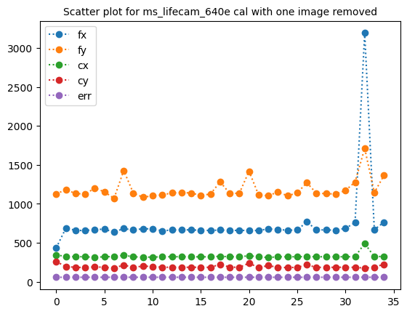
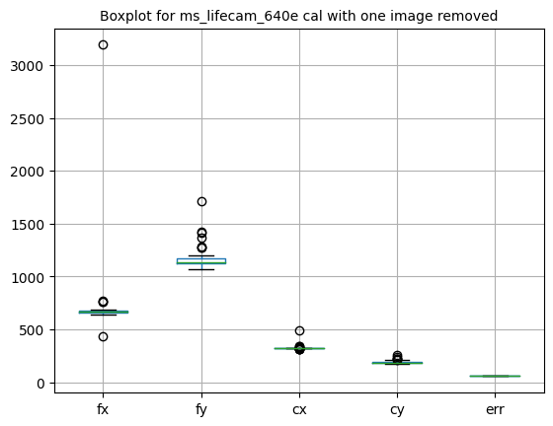
Noise and error with OpenCV - continued
Take a large set and drop images and see how stable we are and get a sense of the sensitivity to one image
Different sets give wildly different fx and fy (and they aren’t the same, so the convention with OpenCV is possibly different from others)
You don’t really get ‘bad outliers’ – they’re usually the corner images that are keeping you closer to reality
Example numbers
fx mean: 740.6 median: 665.3 std: 429.6
fy mean: 1184.5 median: 1137.5 std: 127.2
cx mean: 327.4 median: 321.6 std: 29.4
cy mean: 194.6 median: 186.3 std: 18.3
err mean: 57.9 median: 57.9 std: 0.11
The error is high, compared to what I see from good cal examples
Changing distances and going simple still gives results that are just plain wrong, so there must be a set of parameters that has to be changed to get this right

Slide 18
Checking the intrinsics – fx and fy
MS Lifecam HD 3000

Slide 19
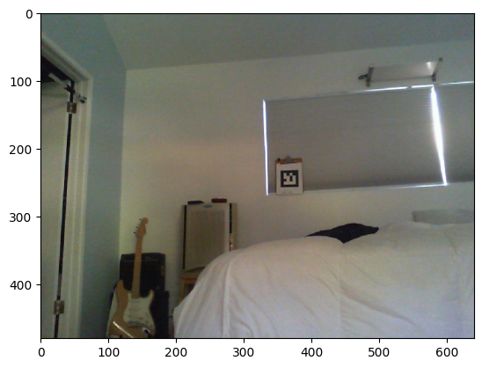
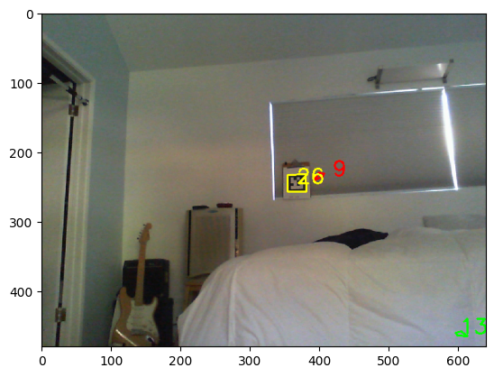
Comparison of techniques with experiment – 640x480
h, w = 480, 640
w_fov = 50.1
h_fov = 39.4
Nominal: [684.7, 670.2, 320, 240 ]
Summary of results
ID: 9 hamming: 2 decision_margin: 0.26
ID: 13 hamming: 2 decision_margin: 0.87
ID: 26 hamming: 0 decision_margin: 37.51
Measured distance in z with Bosch laser = 4.00m. Calculated from AprilTag detector with cals below:

Slide 20
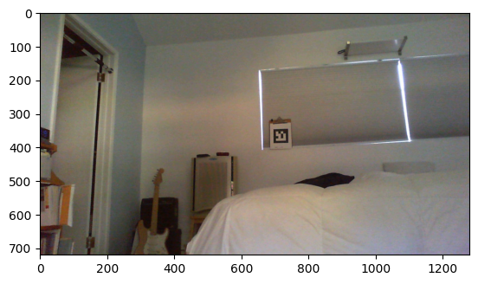

Comparison of techniques with experiment – 1280x720
h, w = 720, 1280
w_fov = 60.2
h_fov = 36.1
Nominal : [ 1104.1, 1104.7, 640, 360 ]
Summary of results
ID: 3 hamming: 2 decision_margin: 0.76
ID: 12 hamming: 2 decision_margin: 0.14
ID: 12 hamming: 1 decision_margin: 0.04
ID: 25 hamming: 2 decision_margin: 1.06
ID: 26 hamming: 0 decision_margin: 24.18
Measured distance in z with Bosch laser = 4.00m. Calculated from AprilTag detector with cals below:

Slide 21
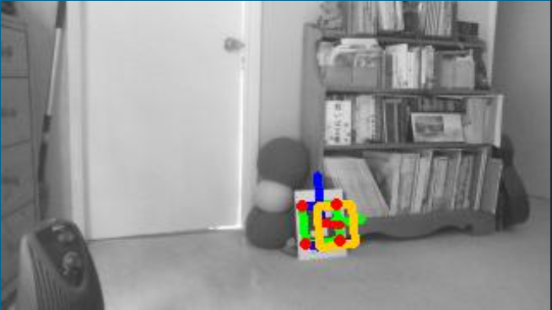
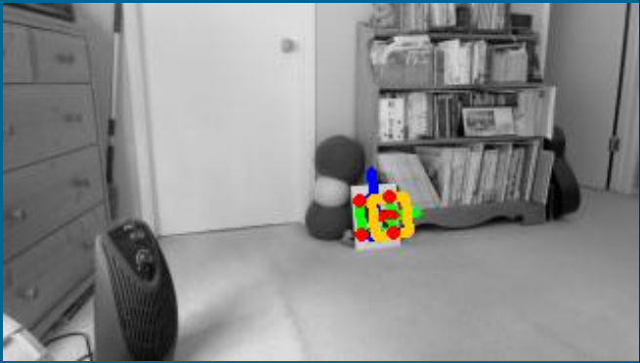
Lifecam
640x360
59x36°
c920
640x360
72x44°

